Slide 1
Introduction to Web programming
0731213

Slide 2
Lecture 1 What is PHP?

Slide 3
What is PHP?
What is PHP?
PHP is an acronym for "PHP: Hypertext Preprocessor"
PHP is a widely-used, open source scripting language
PHP scripts are executed on the server
PHP is free to download and use
PHP is an amazing and popular language!
It is powerful enough to be at the core of the biggest blogging system on the web (WordPress)!
It is deep enough to run the largest social network (Facebook)!
It is also easy enough to be a beginner's first server side language!

Slide 4
A Simple HTML Document
This prints the sentence “My first PHP script” on the screen
<!DOCTYPE html>
<html>
<body>
<?php
echo "My first PHP script!";
?>
</body>
</html>

Slide 5
What is PHP File?
PHP files can contain text, HTML, CSS, JavaScript, and PHP code
PHP code are executed on the server, and the result is returned to the browser as plain HTML
PHP files have extension ".php"

Slide 6
What Can PHP Do?
PHP can generate dynamic page content
PHP can create, open, read, write, delete, and close files on the server
PHP can collect form data
PHP can send and receive cookies
PHP can add, delete, modify data in your database
PHP can be used to control user-access
PHP can encrypt data

Slide 7
Why PHP?
PHP runs on various platforms (Windows, Linux, Unix, Mac OS X, etc.)
PHP is compatible with almost all servers used today (Apache, IIS, etc.)
PHP supports a wide range of databases
PHP is free.
PHP is easy to learn and runs efficiently on the server side

Slide 8
What Do I Need?
To start using PHP install a web server on your own PC, and then install PHP and MySQL
There are some excellent all-in-one Windows distributions that contain Apache, PHP, MySQL and other applications in a single installation file, e.g. XAMPP, WampServer and Web.Developer.
XAMPP is a completely free, easy to install Apache-MySQL-PHP-PERL-PEAR framework. The XAMPP open source package has been set up to be incredibly easy to install and to use. XAMPP saves time and effort and provides the software support for web frameworks like Drupal, Joomla, Moodle, or wikiMedia on any Windows PC.

Slide 9
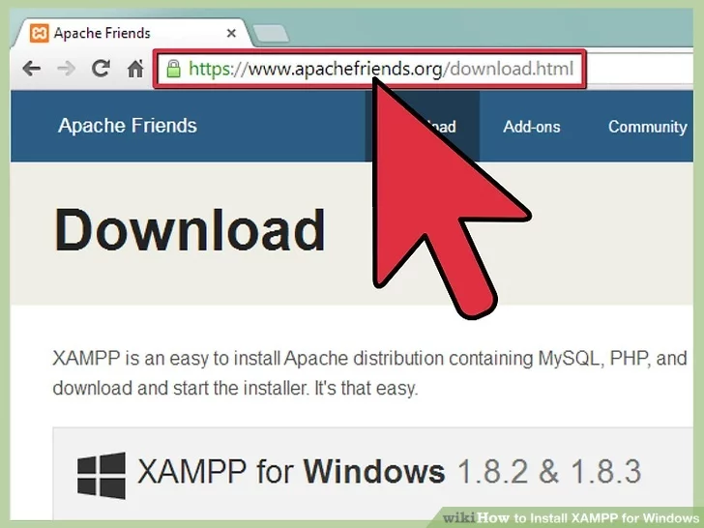
How to Install XAMPP for Windows
Step 1: In your web browser, go to https://www.apachefriends.org/index.html

Slide 10
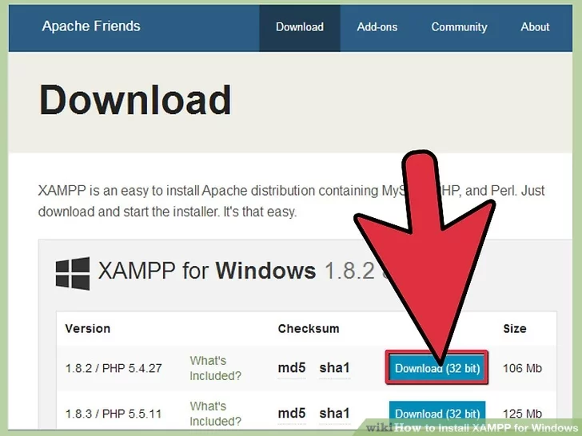
How to Install XAMPP for Windows
Step 2: Click on the download link for XAMPP.

Slide 11
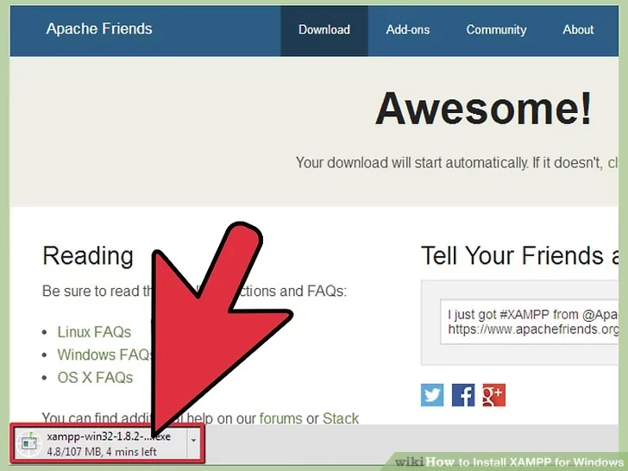
How to Install XAMPP for Windows
Step 3: When prompted for the download, click "Save" and wait for your download to finish.

Slide 12
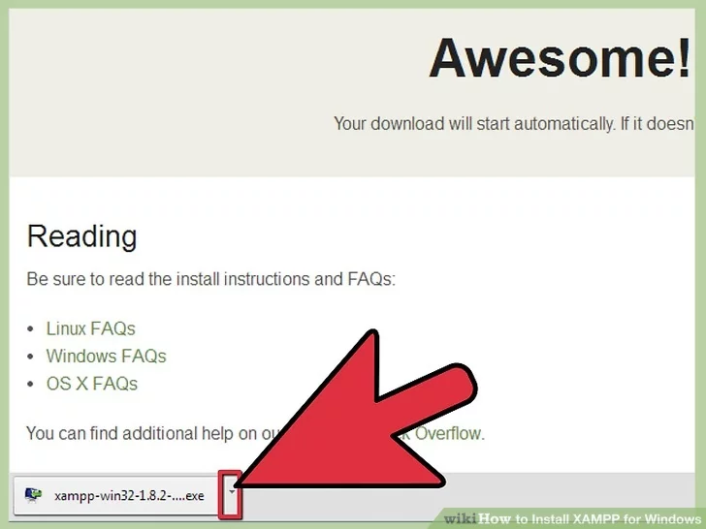
How to Install XAMPP for Windows
Step 4: Open CD or DVD drive from My Computer. Install the program and click on "Run."

Slide 13
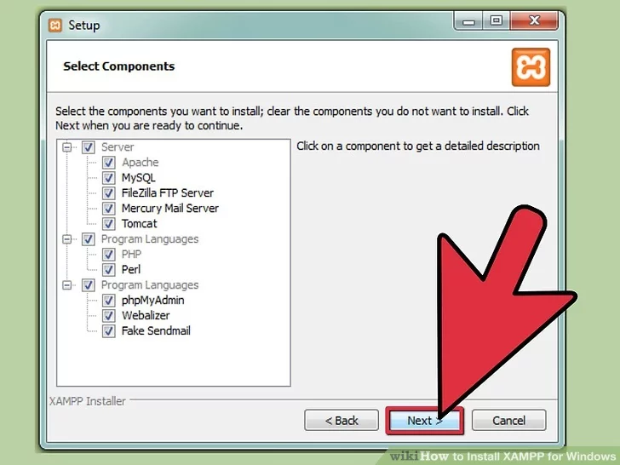
How to Install XAMPP for Windows
Step 5: Accept the default settings. A command will open and offer an initial installation prompt. Just hit the Enter key and accept the default settings.

Slide 14
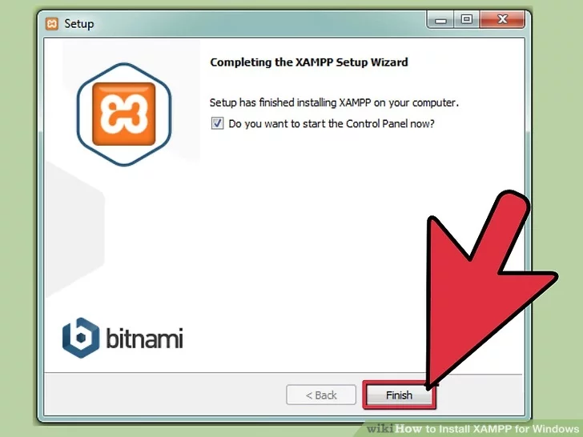
How to Install XAMPP for Windows
Step 6: When your installation is complete, exit the command window by hitting the Enter key.

Slide 15
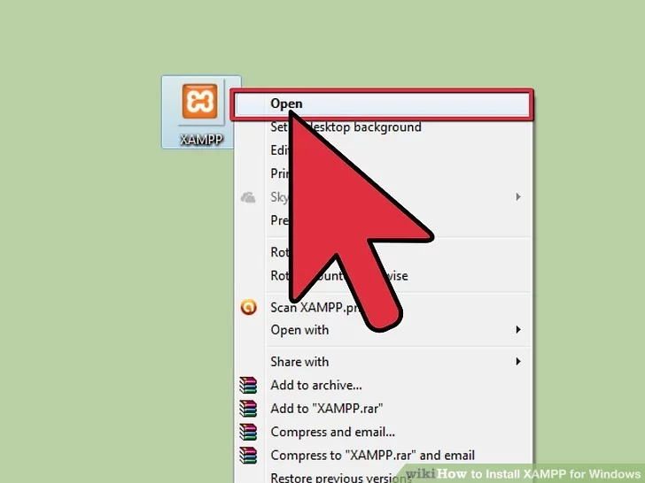
How to Install XAMPP for Windows
Step 7: Start the XAMPP Control Panel.

Slide 16
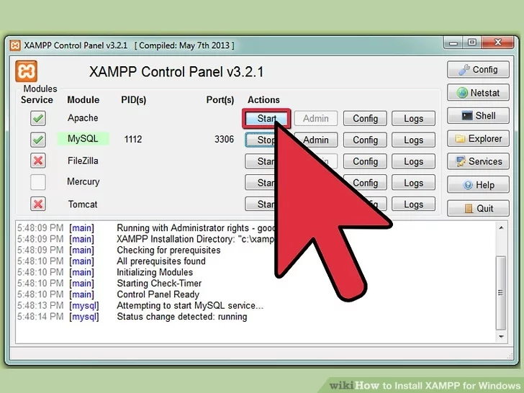
How to Install XAMPP for Windows
Step 8: Start the Apache and MySQL components. You can also start the other components, if you plan to use them.

Slide 17
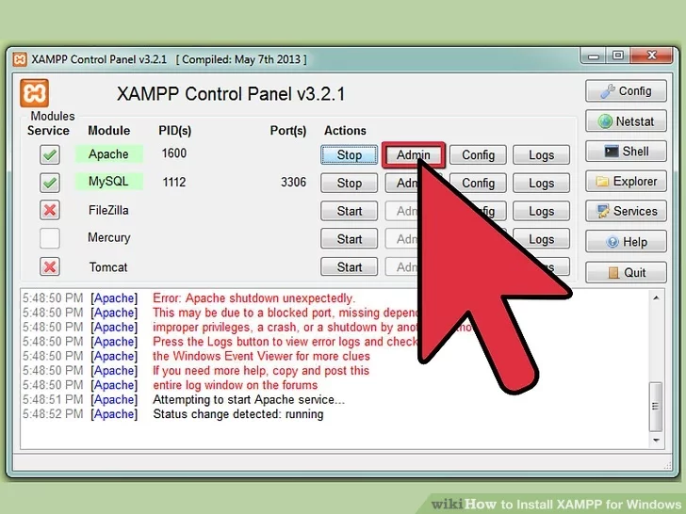
How to Install XAMPP for Windows
Step 9: Verify the Apache install, by clicking on the Apache administrative link in the Control Panel.

Slide 18
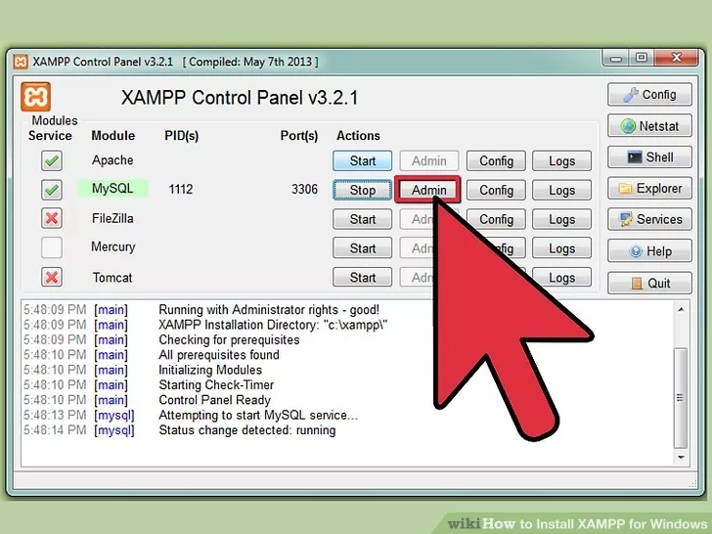
How to Install XAMPP for Windows
Step 10: Verify the MySQL installation, by clicking on the MySQL administrative link in the XAMPP Control Panel.

Slide 19
Run a PHP program in XAMPP Server
Step 1: Install XAMPP.
Step 2: Assume you installed xampp in C Drive. Go to: C:\xampp\htdocs
Step 3: Create your own folder, name it for example as example.
Step 4: Now create your first php program in xampp and name it as “page1.php”:
<!DOCTYPE html>
<html>
<body>
<?php
echo "My first PHP script!";
?>
</body>
</html>

Slide 20
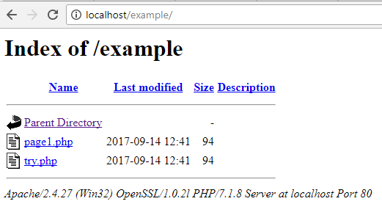
Run a PHP program in XAMPP Server
Step 5: Now type the following on browser: http://localhost/example/ Below screenshot shows php files created under folder “example”

Slide 21
Run a PHP program in XAMPP Server
Step 6: Click on “page1.php” and it will show the following:

Slide 22
Create your website home page
Create your home page under the folder “example” and name it as “index.php” or “default.php”.
Now type the following on browser: http://localhost/example/ Below screenshot shows the home page for your website:
<!DOCTYPE html>
<html>
<body>
<?php
echo “index or default page";
?>
</body>
</html>

Slide 23
Lecture 2 PHP basics (1)

Slide 24
Basic PHP Syntax
A PHP script can be placed anywhere in the document.
A PHP script starts with <?php and ends with ?>:
The default file extension for PHP files is ".php".
A PHP file normally contains HTML tags, and some PHP scripting code.
<?php
// PHP code goes here
?>

Slide 25
Basic PHP Syntax
Below, we have an example of a simple PHP file, with a PHP script that uses a built-in PHP function "echo" to output the text "Hello World!" on a web page:
<!DOCTYPE html>
<html>
<body>
<h1>My first PHP page</h1>
<?php
echo "Hello World!";
?>
</body>
</html>

Slide 26
Comments in PHP
A comment in PHP code is a line that is not read/executed as part of the program. Its only purpose is to be read by someone who is looking at the code.
PHP supports several ways of commenting:
<?php
// This is a single-line comment
# This is also a single-line comment
/*
This is a multiple-lines comment block
that spans over multiple
lines
*/
// You can also use comments to leave out parts of a code line
$x = 5 /* + 15 */ + 5;
echo $x;
?>

Slide 27
PHP Case Sensitivity
In PHP, all keywords (e.g. if, else, while, echo, etc.), classes, functions, and user-defined functions are NOT case-sensitive. In the example below, all three echo statements below are legal (and equal):
However; all variable names are case-sensitive. In the example below, only the first statement will display the value of the $color variable (this is because $color, $COLOR, and $coLOR are treated as three different variables):
<?php
ECHO "Hello World!<br>";
echo "Hello World!<br>";
EcHo "Hello World!<br>";
?>
<?php
$color = "red";
echo "My car is " . $color . "<br>";
echo "My house is " . $COLOR . "<br>";
echo "My boat is " . $coLOR . "<br>";
?>

Slide 28
PHP Variables
Variables are "containers" for storing information.
In PHP, a variable starts with the $ sign, followed by the name of the variable:
After the execution of the statements above, the variable $txt will hold the value Hello world!, the variable $x will hold the value 5, and the variable $y will hold the value 10.5.
Note: When you assign a text value to a variable, put quotes around the value.
Note: Unlike other programming languages, PHP has no command for declaring a variable. It is created the moment you first assign a value to it.
<?php
$txt = "Hello world!";
$x = 5;
$y = 10.5;
?>

Slide 29
Rules for PHP variables
A variable starts with the $ sign, followed by the name of the variable
A variable name must start with a letter or the underscore character
A variable name cannot start with a number
A variable name can only contain alpha-numeric characters and underscores (A-z, 0-9, and _ )
Variable names are case-sensitive ($age and $AGE are two different variables)

Slide 30
Output Variables
The PHP echo statement is often used to output data to the screen.
The following example will show how to output text and a variable using echo statement :
The following example will produce the same output as the example above:
The following example will output the sum of two variables:
<?php
$txt = "W3Schools.com";
echo "I love $txt!";
?>
<?php
$txt = "W3Schools.com";
echo "I love " . $txt . "!";
?>
<?php
$x = 5;
$y = 4;
echo $x + $y;
?>

Slide 31
Lecture 3 PHP basics (2)

Slide 32
PHP Data Types
Variables can store data of different types, and different data types can do different things.
PHP supports the following data types:
String
Integer
Float (floating point numbers - also called double)
Boolean
Array
Object
NULL
Resource

Slide 33
PHP String
A string is a sequence of characters, like "Hello world!".
A string can be any text inside quotes. You can use single or double quotes:
<?php
$x = "Hello world!";
$y = 'Hello world!';
echo $x;
echo "<br>";
echo $y;
?>

Slide 34
PHP String
PHP String Functions
Get The Length of a String: The PHP strlen() function returns the length of a string.
Count The Number of Words in a String: The PHP str_word_count() function counts the number of words in a string:
Reverse a String: The PHP strrev() function reverses a string
<?php
echo strlen("Hello world!"); // outputs 12
?>
<?php
echo str_word_count("Hello world!"); // outputs 2
?>
<?php
echo strrev("Hello world!"); // outputs !dlrow olleH
?>

Slide 35
PHP String
PHP String Functions
Search For a Specific Text Within a String: The PHP strpos() function searches for a specific text within a string. If a match is found, the function returns the character position of the first match. If no match is found, it will return FALSE.
Replace Text Within a String: The PHP str_replace() function replaces some characters with some other characters in a string.
<?php
echo strpos("Hello world!", "world"); // outputs 6
?>
<?php
echo str_replace("world", "Dolly", "Hello world!"); // outputs Hello Dolly!
?>

Slide 36
PHP Integer
An integer data type is a non-decimal number between -2,147,483,648 and 2,147,483,647.
<?php
$x = 5985;
var_dump($x);
?>

Slide 37
PHP Float
A float (floating point number) is a number with a decimal point or a number in exponential form.
In the following example $x is a float. The PHP var_dump() function returns the data type and value:
<?php
$x = 10.365;
var_dump($x);
?>

Slide 38
PHP Boolean
A Boolean represents two possible states: TRUE or FALSE.
Booleans are often used in conditional testing.
<?php
$x = true;
$y = false;
?>

Slide 39
PHP Array
An array stores multiple values in one single variable.
In the following example $cars is an array. The PHP var_dump() function returns the data type and value:
<?php
$cars = array("Volvo","BMW","Toyota");
var_dump($cars);
?>

Slide 40
PHP Constants
A constant is an identifier (name) for a simple value. The value cannot be changed during the script.
A valid constant name starts with a letter or underscore (no $ sign before the constant name).
To create a constant, use the define() function.
Parameters:
name: Specifies the name of the constant
value: Specifies the value of the constant
case-insensitive: Specifies whether the constant name should be case-insensitive. Default is false
define(name, value, case-insensitive)

Slide 41
PHP Constants
The example below creates a constant with a case-sensitive name:
The example below creates a constant with a case-insensitive name:
<?php
define("GREETING", "Welcome to W3Schools.com!");
echo GREETING;
?>
<?php
define("GREETING", "Welcome to W3Schools.com!", true);
echo greeting;
?>

Slide 42
Self Study
PHP Variables Scope; Global & Local Scope (https://www.w3schools.com/php/php_variables.asp)
PHP The global Keyword (https://www.w3schools.com/php/php_variables.asp)
PHP The static Keyword (https://www.w3schools.com/php/php_variables.asp)
The PHP print Statement (https://www.w3schools.com/php/php_echo_print.asp)
PHP Operators (https://www.w3schools.com/php/php_operators.asp)

Slide 43
References
https://www.w3schools.com/
Robin Nixon, Learning PHP, MySQL, JavaScript, and CSS, 2013
Mike McGrath, PHP & My SQL in easy steps, 2012.

Slide 44
The End

